Slide 1
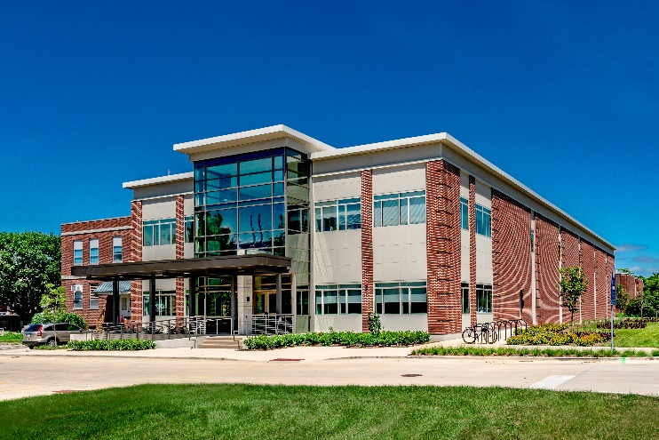
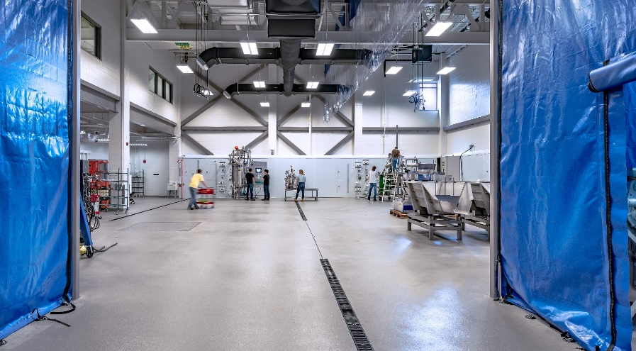
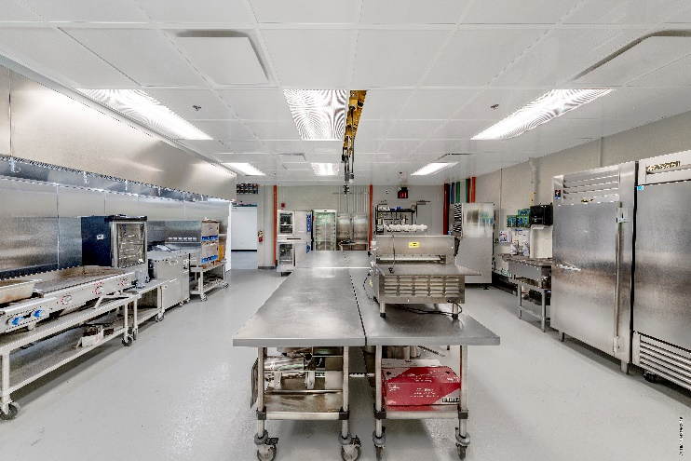
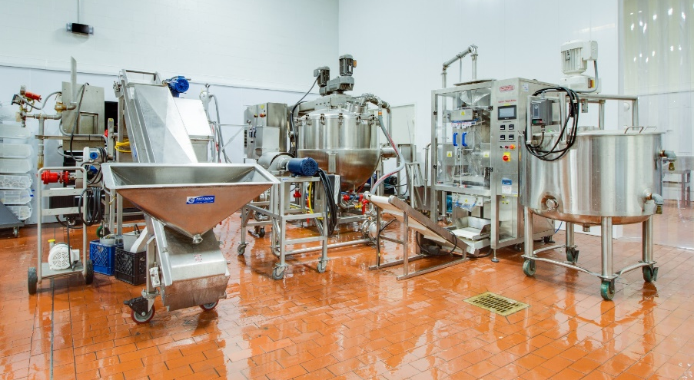
IBRL & FSHN-PPP Facility & Safety Orientation
University of Illinois at Urbana-Champaign
6/7/24 - Rev. 5

Slide 2
Training Program Overview
Overview Orientation (this presentation)
Basic facility rules
Review of hazards
Dress code & PPE review
Hands-On Equipment Training
Provided on an as-needed basis when utilizing specific equipment in facilities
DRS Trainings (Internal Only)
Before beginning work
Laboratory Safety
Within 1 month of beginning work
Fire Extinguisher
Chemical Safety: An Introduction
Chemical Spills
Compressed Gases & Cryogens
Hazard Communication (Right-to-know)
Electrical Safety: Fundamentals
Within 3 months of beginning work
Understanding Biosafety
Awareness Training for the Transport of Hazardous Material

Slide 3
Training Program Overview
Safety Workshops
In-depth trainings provided to cover common safety topics such as:
Steam Safety
Electrical Safety
Chemical Handling
Ladder Safety
Power Tool Handling
Pinch Points
Hands-On Technical Training
In-depth hands-on trainings provided to cover common skills such as:
Bioprocessing Lab Skills (Basic – centrifuge, pipetting, balances, lab waste disposal, pH, moisture, conductivity, turbidity)
Bioprocessing Lab Skills (Advanced – OD, PCV,
Bioprocessing Lab Skills (Expert – HPLC/GC/Protein Analyzer sample prep and analysis, aseptic handling in biosafety cabinet)
Equipment Cleaning & Sanitizing
Hose, Piping, & Valve Selections – how to choose for your application
Bioprocessing Controls Skills (Basic – VFDs, Potentiometers, thermocouples, pressure sensors)
Bioprocessing Controls Skills (Advanced – PID controls, I/P converters, control valves)

Slide 4
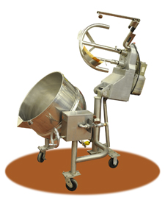
What is a Pilot Plant?
“A small industrial system, which is operated to generate information about the behavior of the system for use in design of larger facilities or equipment.”
Scale is important
Bench
Pilot
Demonstration/ Semi-Works
IBRL & FSHN-PPP used for:
Teaching – Degree & continuing education
Research – Internal or external to the University
Industry Projects, Extension, & Outreach – Industry & public knowledge transfer

Slide 5
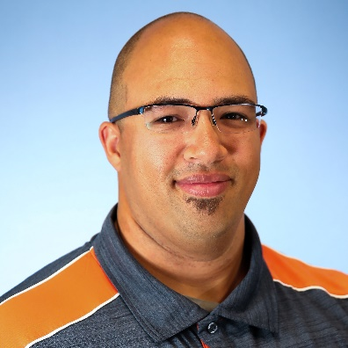
IBRL Team
Brian Jacobson
Assoc Dir of Strategic Operations
IBRL 2004
Beth Conerty
Assoc Dir of Business Development
IBRL 2008
Jedi Brown
Senior Pilot Plant Specialist
FSHN-PPP
AESB 187
Phillip Manning
Senior Pilot Plant Specialist
Fermentation
IBRL 2003
Marissa Nyland
Assistant Dir of Operations & Safety
IBRL 2010
Tom McKenna
Senior Pilot Plant Specialist
DSP
IBRL 1024
Amy Rogers
Senior Business Development Coordinator
IBRL 2001
Kerri Peters
Office Manager
IBRL 1005

Slide 6
IBRL Team
Dave Baudo
Pilot Plant Specialist
IBRL 2031
Drew Borbely Pilot Plant Specialist AESB 174
Bobby Crowley
Pilot Plant Specialist
IBRL 1033
Adam Davis
Junior Pilot Plant Specialist
IBRL 1001
Joe Melnick Junior Pilot Plant Specialist AESB 174
Nancy McCrone
Analytical Lab Specialist
IBRL 2044
Hana Ostrander Junior Pilot Plant Specialist IBRL 2044
Hope Park
Junior Pilot Plant Specialist
IBRL 1001
Suneet Takhar
Analytical Lab Specialist
IBRL 1003
Kevin Wu
Junior Pilot Plant Specialist
IBRL 2031

Slide 7
Confidentiality
Projects in the facilities often involve sensitive and/or confidential information. Unless explicit permission is given by the Management Team, all projects should be treated as confidential and not discussed in any way. This includes, but is not limited to the following:
Company or personnel names, project identifiers
Project information, work sheets, recipes, materials, or SOPs
Processes or equipment settings specific to an individual project
Results, reports, or data of any kind
Do not transfer any items in or out of facility without permission from the Management Team. All project materials & equipment must be properly labeled and stored in designated areas.
When in doubt about whether information should be treated as confidential, ask a member of the Management Team

Slide 8
Facility Access
Facility business hours are generally from 8:30am-4:30pm
Access only permitted to trained individuals with permission of Management Team
All individuals must complete the “Safety Orientation Checklist” prior to using the facility
After-hours access (limited) requires 2 individuals who have completed the “Safety Orientation Checklist”
IBRL
Access to pilot plant, lab, classroom, office, and storage areas are controlled via logged proximity card access. Building entry permitted only through main (West) or ABL-connected entrances. All other exits designated as emergency exits only.
Proximity cards are not to be shared without permission of IBRL Management. Do not allow others to “piggy-back” your entrance.
All proximity cards must be returned at completion of project. Lost Cards must be reported immediately.
FSHN-PPP
Access to facility spaces must only be from doors connected to main hallway of AESB. Other doors are usable only in an emergency.

Slide 9
General Safety
The Pilot Plant facilities are a safe place to work, but there are serious hazards that you must be aware of and account for.
A Pilot Plant is significantly different than a kitchen or laboratory and you must always be aware of your surroundings.
A pilot plant is by design an ever-changing facility designed to flex to the needs of current projects. There are many different personnel and guests in the facility and little routine to define operations day to day.
Incomplete list of hazards contained in Pilot Plant facility
Hot, sharp, or rapidly rotating equipment
High pressure steam (100 psi/ ~300F)
High voltage electricity (208V & 460V 3-Phase)
Wet floors and protruding trip hazards
Usage of chemicals in process and for cleaning
Corrosive, poisonous, and/or flammable chemicals
Heavy equipment, overhead cranes, and fork truck traffic
If you have questions or concerns, please ask!

Slide 10
Safety Signage
DANGER
If danger is not avoided, it will cause death or serious injury
WARNING
If the warning is not heeded, it can cause death or serious injury
CAUTION
If precaution is not taken, it may cause minor or moderate injury
NOTICE
Used to signify locations of items, instructions, rules, or directions unrelated to personal injury

Slide 11
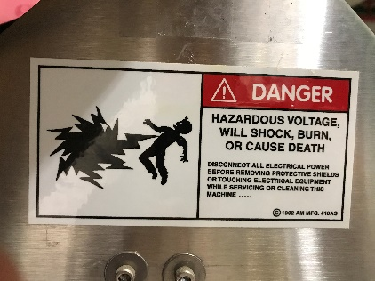
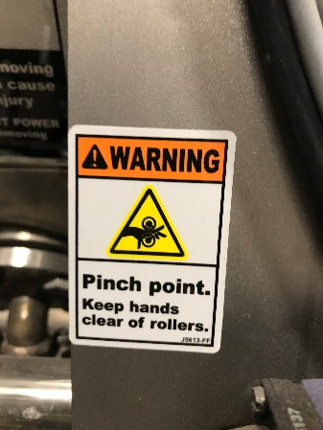
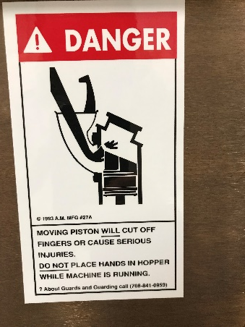
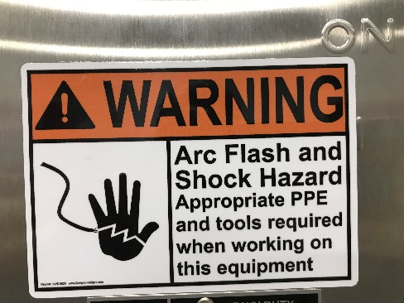
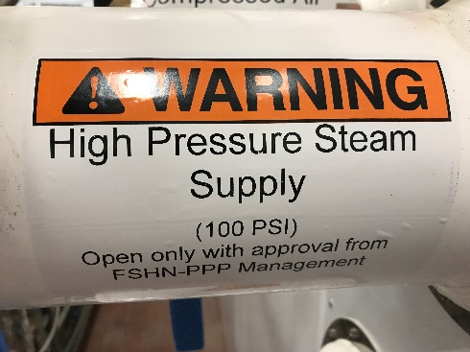
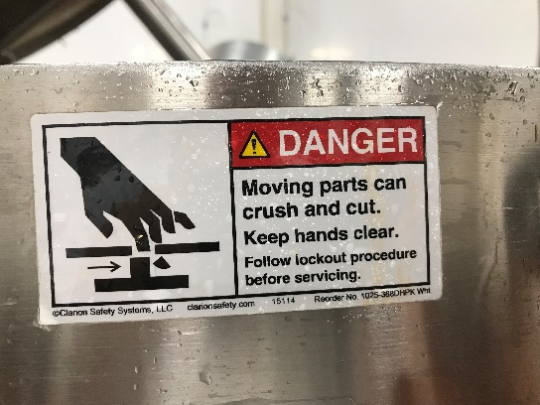
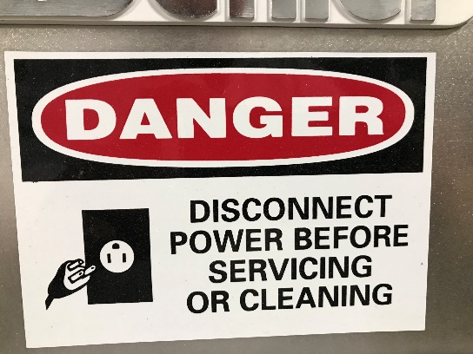
Safety Signage (completion in progress)

Slide 12
Quick Disconnect Utilities
Available Utilities
High Pressure Steam (100psi)
Clean Steam (80psi)
Process Chill Water Loop
Natural Gas (select locations)
Compressed Air
Vacuum
Potable cold water
DI Water
Nitrogen
Specialty Gas
3ph 208V/460V power
1ph 120V/208V power
All utilities, excluding potable cold water are locked out. Only the Management Team can open utility valves.

Slide 13
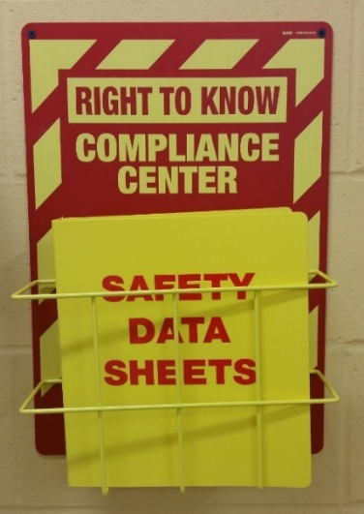
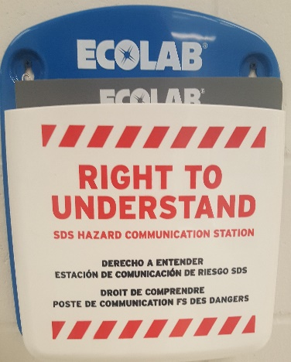
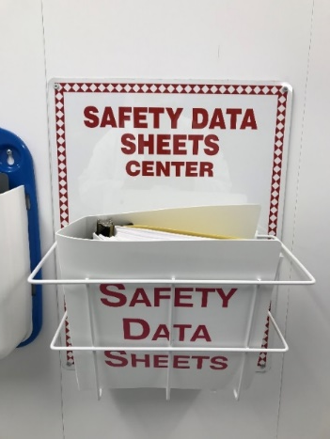
SDS & Hazard Communication Plan IBRL
IBRL Pilot Plant
Review hazards of chemical in use and inform others in area of those hazards
All chemicals must be properly labelled with the compound, concentration, date, and name of person who prepared it.
Bulk chemicals (drums) only to be handled by Pilot Plant Specialists
Hazard Communication Plan & SDS forms location
IBRL – IBRL 1010 – Pilot Plant & IBRL 2051 – Laboratory
FSHN-PPP – AESB 185 – Pilot Plant Entrance
Chemical storage
IBRL – IBRL 1010 & IBRL 2051 & AESB Outdoor
FSHN-PPP – AESB 181
Spill Response Kit Location
IBRL – IBRL 1010 & IBRL 2051 & AESB Outdoor
FSHN-PPP – AESB 190
FSHN-PPP
IBRL Lab

Slide 14
SDS & Hazard Communication Cont.
The Hazard Communication Standard requires chemical manufacturers, distributors, or importers to provide Safety Data Sheets (SDSs) to communicate the hazards of hazardous chemical products.
SDS contain information on:
Identification
Hazard(s) identification
Composition/information on ingredients
First-aid measures
Fire-fighting measures
Accidental release measures
Handling and Storage
Exposure controls/personal protection

Slide 15
Equipment Use
Do NOT power on any equipment until you are familiar with:
How to safely connect it to utilities
How to safely operate it
How to safely stop/disconnect it from utilities
How to disassemble, clean, and reassemble it
Use of any equipment requires prior permission from the Management Team and equipment-specific training.
Unplug equipment when cleaning, disassembling, and not in use. Always assume equipment is energized.
Equipment SOP, manuals & training binders available
IBRL - IBRL 1010 - Pilot Plant Dock Hallway (Across from Workshop)
FSHN-PPP - AESB 186 - Shin Family Conference Room

Slide 16
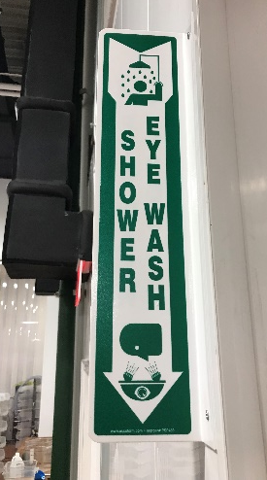
In Case of Emergency
Immediately notify a member of the Management Team of any injuries or safety concerns. In emergency, Dial 911 from cell phone or facility phones located:
IBRL 1010 - Pilot Plant
IBRL 2051 – Laboratory
IBRL 1053 – Workshop
AESB 186 – Shin Family Conference Room
First Aid Kit Locations
IBRL 1010 – Pilot Plant Entrance
IBRL 2051 – Laboratory West Wall
AESB 185 – Pilot Plant Entrance
AESB 190 - Food Analysis Laboratory
AESB 194 – Product Development Kitchen
Defibrillator available in hallway near IBRL 1033 & in AESB near washrooms
Safety Shower & Eye Wash Locations
IBRL 1010- East & West end of Pilot Plant
IBRL 1072- South end of Volatile Room
IBRL 2051- North & South end of Lab
AESB 185 – Near Pilot Plant Entrance Hand Sink
AESB 190 – Near Hallway Door of Food Analysis Laboratory
Become aware of locations in your area

Slide 17
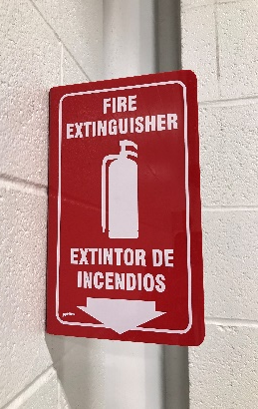
In Case of Emergency
Fire extinguishers available throughout facilities
Become aware of locations in your work area
IBRL 2051 – Laboratory has electrical shut-off switches on both exits
(RUN) Tornado/Natural Disaster
IBRL – Shelter in basement hallway
AESB – Shelter in hallway next to elevator
(RUN) Fire
IBRL – Assemble outside near IBRL dock or in AESB south hallway
AESB – Assemble in IBRL main entrance across parking lto

Slide 18
Dress Code
Clothing
Sleeved shirt
NO exposed shoulders or bare stomachs
Long Pants
Denim or khaki material preferred
NO sweatpants or leggings allowed
Closed-toed shoes with ankle support
Boots preferred; sturdy tennis shoes acceptable
NO sandals, crocs, or lightweight shoes allowed
No loose/long clothing, hair, or jewelry
Consult a member of the management team before bringing a cell phone into the pilot plant or lab.
Locker storage (provide your own lock) and showers (bring your own toiletries/towel) available

Slide 19
Personal Protective Equipment
Safety Glasses
Glasses and lens cleaner available
All personal glasses must be ANSI Z87.1 certified
“Over Glasses” Safety Glasses available
Hearing Protection
Available for use as needed with loud equipment
Hand Protection
Nitrile Lab Gloves
Food Handling
Hot-handling
Hot and wet-handling gloves
Work gloves
Cryo gloves
Lab Coat
FSHN-PPP – Required at all times in AESB 185 – Pilot Plant or AESB 194 – Product Development Kitchen (available in pilot plant entrance)
IBRL – available in IBRL Lab Storage as needed
For special needs or other concerns, please notify the Management Team

Slide 20
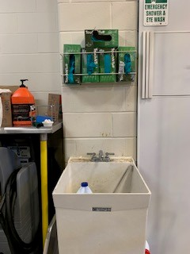
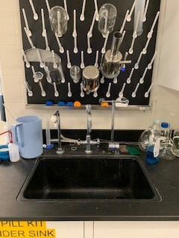
IBRL Cleaning
Your work area is expected to be kept in a clean and organized manner. Final cleaning and waste removal expectations will be discussed with the Management Team before beginning work.
Cleaning supplies are located near sink at East and West ends of Pilot Plant & middle of Laboratory
Surplus supplies stored in IBRL 007
All solids must be swept and placed in garbage can before spraying down the floor. DO NOT wash any solids down the drain.
Be aware of electrical hazards when spraying water & cleaning equipment. Ensure all equipment is disconnected before beginning cleaning process.
Do not leave items in wash sinks
Pilot Plant
LAB

Slide 21
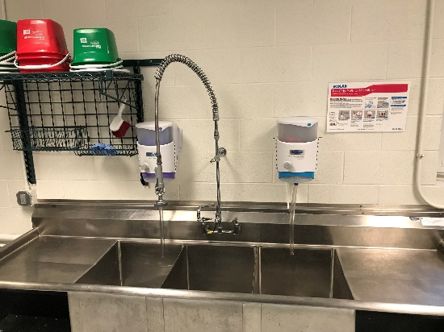
FSHN-PPP Cleaning
YOU are expected to clean after using any FSHN-PPP space or equipment
Cleaning supplies are located near sink
Surplus supplies stored in AESB 181
All cleaning activities must properly utilize 3-basin sink, dishwasher, or mobile cleaning carts
Wash – Remove food particles and other types of soil
Rinse
Sanitize – Reduce the number of microorganisms
All solids must be swept and placed in garbage can before spraying down the floor. DO NOT wash any solids down the drain.
Be aware of electrical hazards when spraying water & cleaning equipment. Ensure all equipment is disconnected before beginning cleaning process.
Do not place/leave any sharp objects in sink.

Slide 22
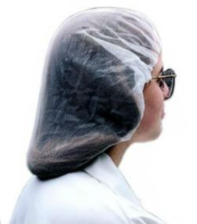
FSHN-PPP Hygiene
Hair nets required at all times
For those with long hair, two may be necessary to fully contain hair
Beard nets required when applicable
Hand washing
Rinse, soap, rub vigorously for 20 seconds, rinse, dry
Must wash
Upon entry to the food processing facility
After touching bare human body parts other than clean hands
After sneezing, coughing, or touching face or mouth
After handling soiled equipment or utensils, or switching tasks
Illnesses to exempt participation
Sore throat with fever, vomiting, diarrhea, or jaundice in past 24 hours
Infected cuts or burns on hands or wrists
Diagnosis of Hepatitis A, Salmonella Typhi, toxin producing E. Coli, Norovirus, Shigella spp.

Slide 23
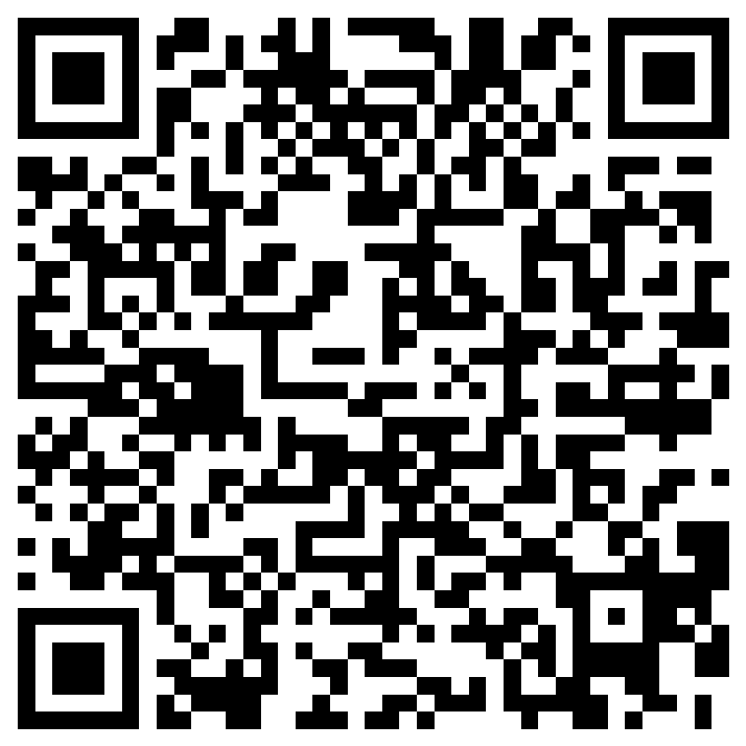
Scan the QR code to complete your Safety Orientation
This electronic forms serves as required documentation for safety compliance.
Hard copies are available upon request.

