Slide 1
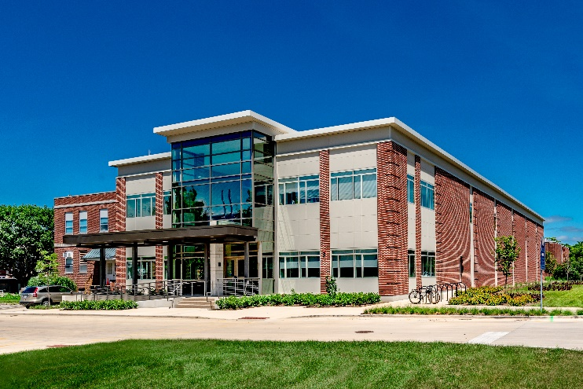
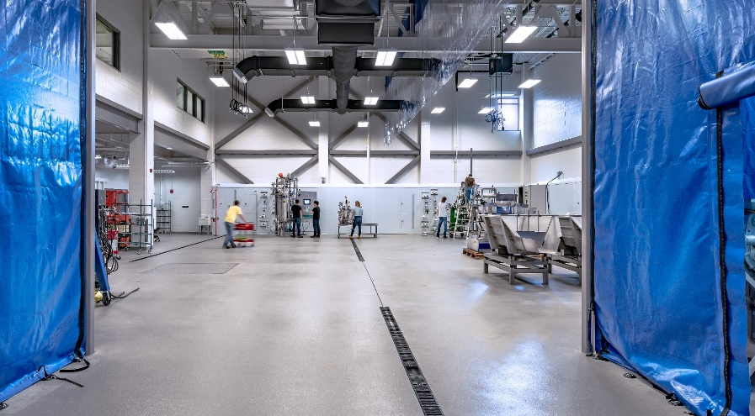
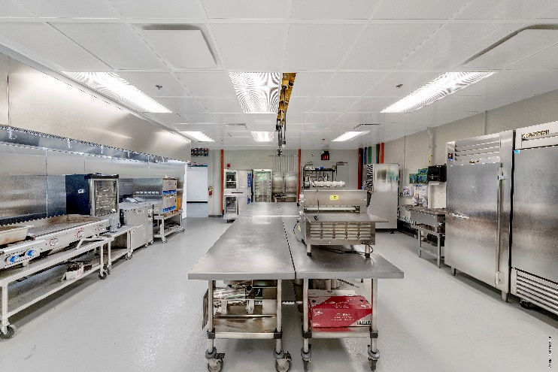
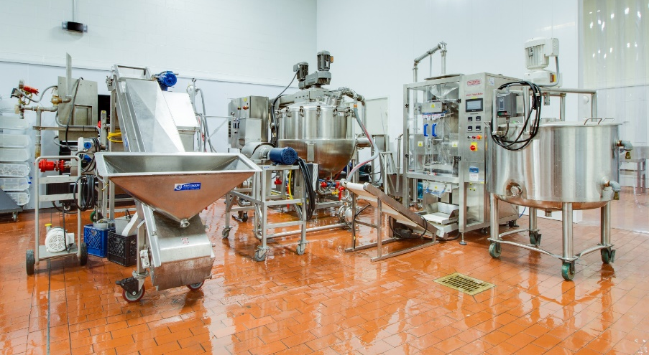
IBRL & FSHN-PPP
Facility & Safety Orientation
University of Illinois at Urbana-Champaign
6/7/24 - Rev. 6

Slide 2
Training Program Overview
Overview Orientation (this presentation)
  Basic facility rules
  Review of hazards
  Dress code & PPE review
Hands-On Equipment Training
  Provided on an as-needed basis when utilizing specific equipment in facilities

Slide 3


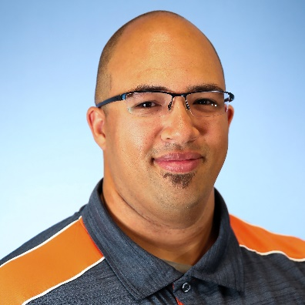





IBRL Team
Brian Jacobson
Assoc Dir of Strategic Operations
IBRL 2004
Beth Conerty
Assoc Dir of Business Development
IBRL 2008
Jedi Brown
Senior Pilot Plant Specialist
FSHN-PPP
AESB 187
Phillip Manning
Senior Pilot Plant Specialist
Fermentation
IBRL 2003
Marissa Nyland
Assistant Dir of Operations & Safety
IBRL 2010
Tom McKenna
Senior Pilot Plant Specialist
DSP
IBRL 1024
Amy Rogers
Senior Business Development Coordinator
IBRL 2001
Kerri Peters
Office Manager
IBRL 1005

Slide 4










IBRL Team
Dave Baudo
Pilot Plant Specialist
IBRL 2031
Drew Borbely Pilot Plant Specialist AESB 174
Bobby Crowley
Pilot Plant Specialist
IBRL 1033
Adam Davis
Junior Pilot Plant Specialist
IBRL 1001
Joe Melnick Junior Pilot Plant Specialist AESB 174
Nancy McCrone
Analytical Lab Specialist
IBRL 2044
Hana Ostrander Junior Pilot Plant Specialist IBRL 2044
Hope Park
Junior Pilot Plant Specialist
IBRL 1001
Suneet Takhar
Analytical Lab Specialist
IBRL 1003
Kevin Wu
Junior Pilot Plant Specialist
IBRL 2031

Slide 5
Confidentiality
Projects in the facilities often involve sensitive and/or confidential information. Unless explicit permission is given by the Management Team, all projects should be treated as confidential and not discussed in any way. This includes, but is not limited to the following:
  Company or personnel names, project identifiers
  Project information, work sheets, recipes, materials, or SOPs
  Processes or equipment settings specific to an individual project
  Results, reports, or data of any kind
Do not transfer any items in or out of facility without permission from the Management Team. All project materials & equipment must be properly labeled and stored in designated areas.
When in doubt about whether information should be treated as confidential, ask a member of the Management Team

Slide 6
Facility Access
Facility business hours are generally from 8:30am-4:30pm
Access only permitted to trained individuals with permission of Management Team
  All individuals must complete the “Safety Orientation Checklist” prior to using the facility
  After-hours access (limited) requires 2 individuals who have completed the “Safety Orientation Checklist”
IBRL
  Access to pilot plant, lab, classroom, office, and storage areas are controlled via logged proximity card access. Building entry permitted only through main (West) or ABL-connected entrances. All other exits designated as emergency exits only.
  Proximity cards are not to be shared without permission of IBRL Management. Do not allow others to “piggy-back” your entrance.
  All proximity cards must be returned at completion of project. Lost Cards must be reported immediately.
FSHN-PPP
  Access to facility spaces must only be from doors connected to main hallway of AESB. Other doors are usable only in an emergency.

Slide 7
General Safety
The Pilot Plant facilities are a safe place to work, but there are serious hazards that you must be aware of and account for.
A Pilot Plant is significantly different than a kitchen or laboratory and you must always be aware of your surroundings.
A pilot plant is by design an ever-changing facility designed to flex to the needs of current projects. There are many different personnel and guests in the facility and little routine to define operations day to day.
Incomplete list of hazards contained in Pilot Plant facility
    Hot, sharp, or rapidly rotating equipment
    High pressure steam (100 psi/ ~300F)
    High voltage electricity (208V & 460V 3-Phase)
    Wet floors and protruding trip hazards
    Usage of chemicals in process and for cleaning
    Corrosive, poisonous, and/or flammable chemicals
    Heavy equipment, overhead cranes, and fork truck traffic
If you have questions or concerns, please ask!

Slide 8
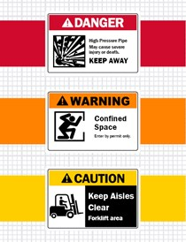
Safety Signage
DANGER
  If danger is not avoided, it will cause death or serious injury
WARNING
  If the warning is not heeded, it can cause death or serious injury
CAUTION
  If precaution is not taken, it may cause minor or moderate injury
NOTICE
  Used to signify locations of items, instructions, rules, or directions unrelated to personal injury

Slide 9
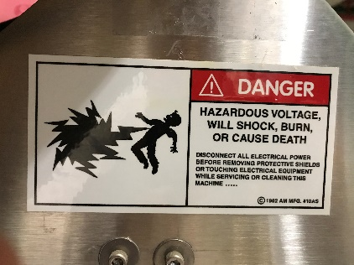
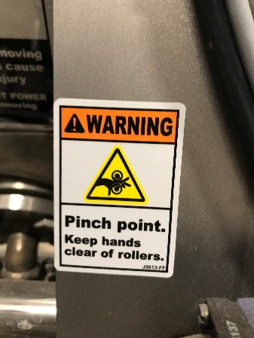
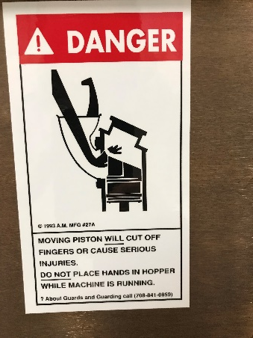
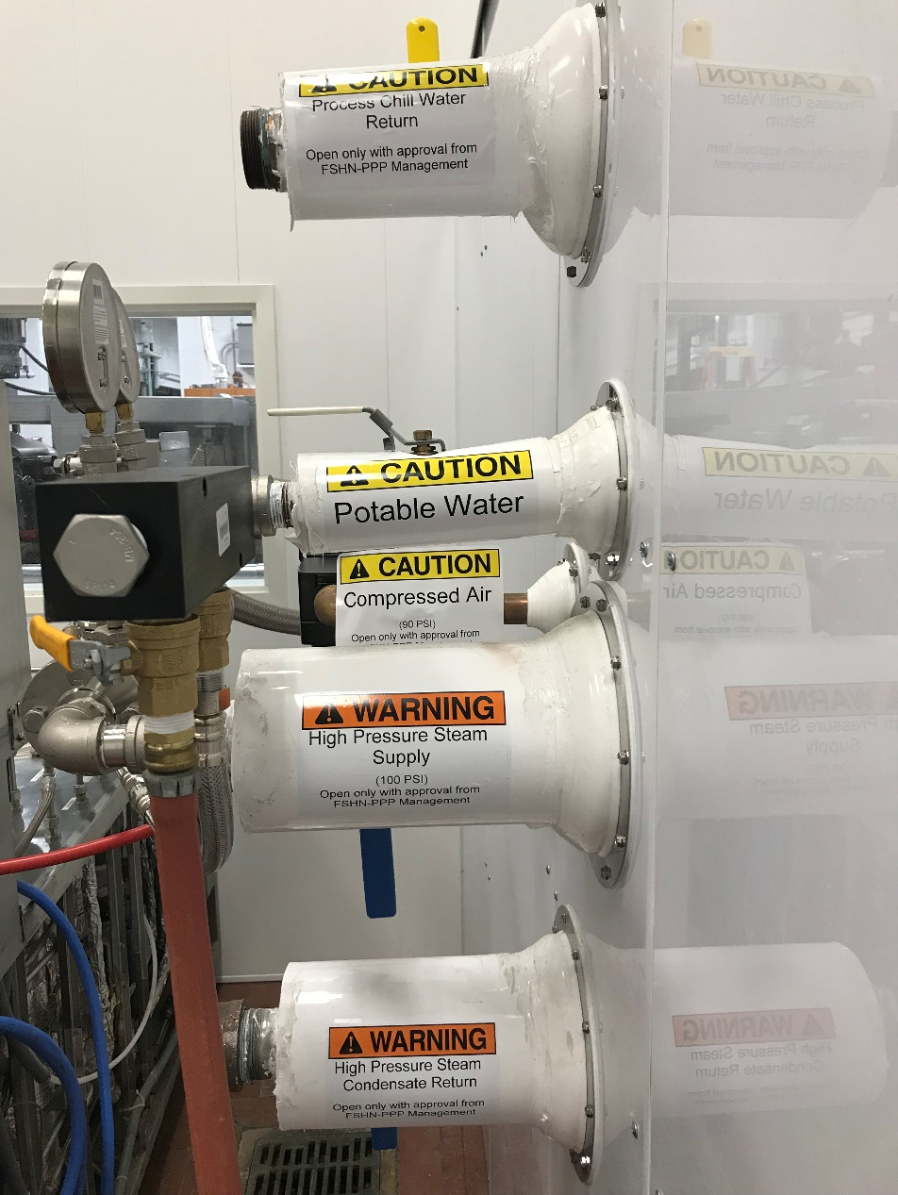
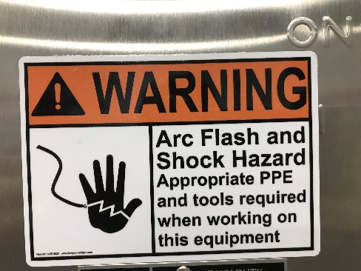
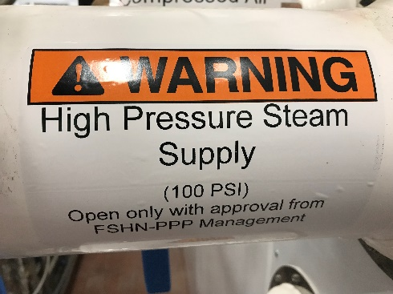
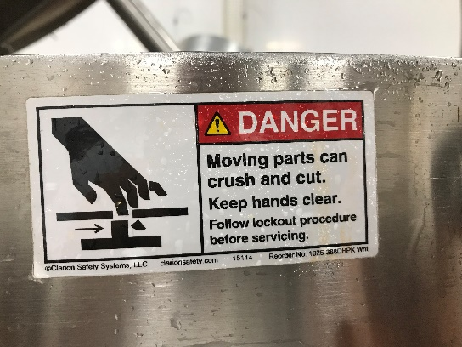
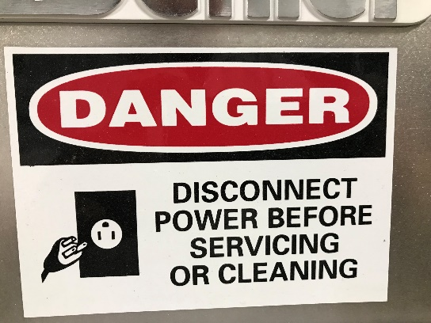
Safety Signage (completion in progress)

Slide 10
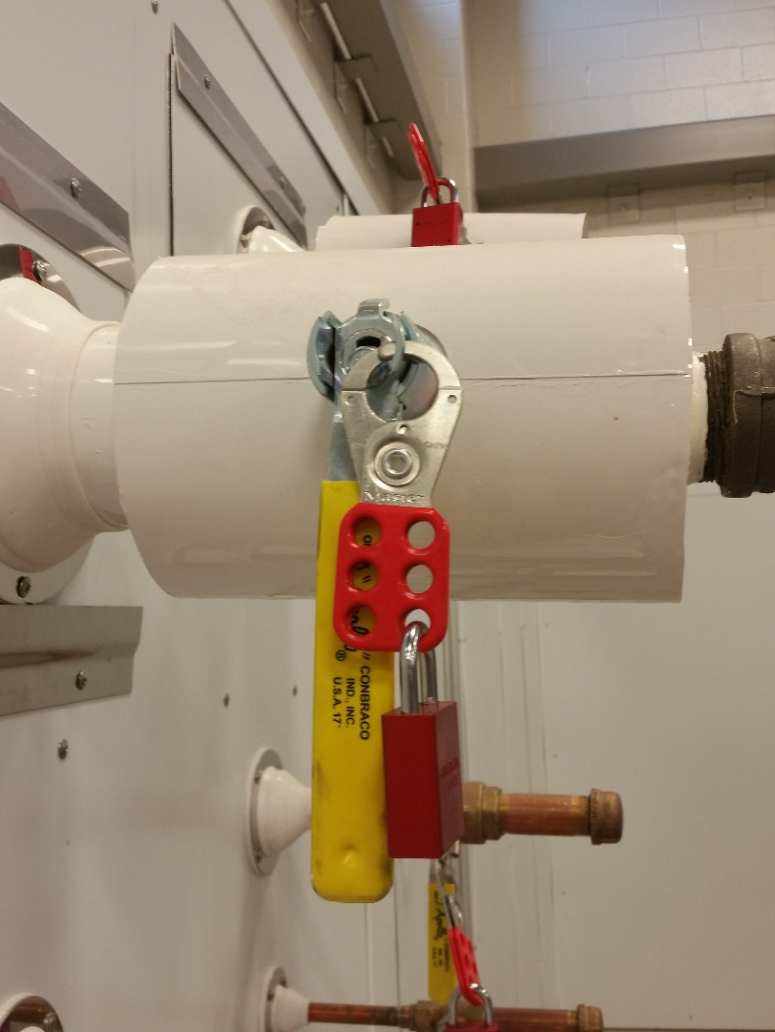
Quick Disconnect Utilities
Available Utilities
  High Pressure Steam (100psi)
  Clean Steam (80psi)
  Process Chill Water Loop
  Natural Gas (select locations)
  Compressed Air
  Vacuum
  Potable cold water
  DI Water
  Nitrogen
  Specialty Gas
  3ph 208V/460V power
  1ph 120V/208V power
All utilities, excluding potable cold water are locked out. Only the Management Team can open utility valves.

Slide 11
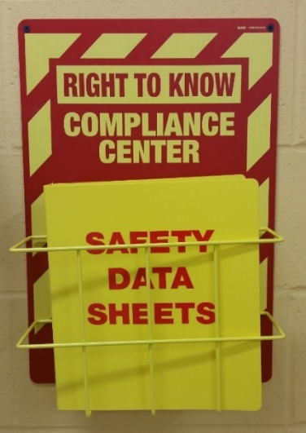
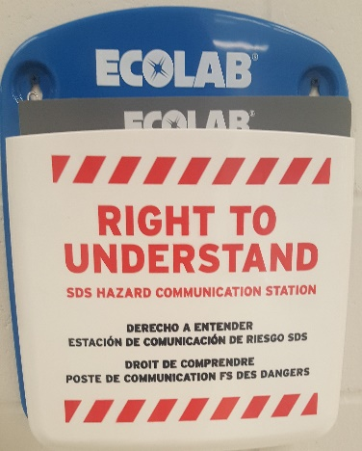
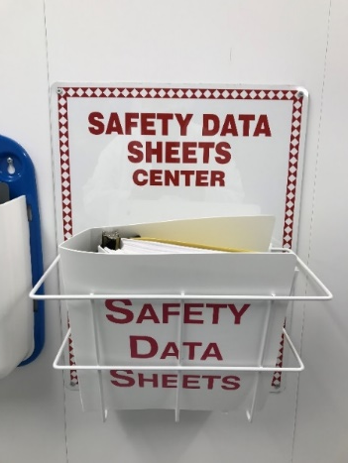
SDS & Hazard Communication Plan IBRL
IBRL Pilot Plant
Review hazards of chemical in use and inform others in area of those hazards
All chemicals must be properly labelled with the compound, concentration, date, and name of person who prepared it.
Bulk chemicals (drums) only to be handled by Pilot Plant Specialists
Hazard Communication Plan & SDS forms location
  IBRL – IBRL 1010 – Pilot Plant & IBRL 2051 – Laboratory
  FSHN-PPP – AESB 185 – Pilot Plant Entrance
Chemical storage
  IBRL – IBRL 1010 & IBRL 2051 & AESB Outdoor
  FSHN-PPP – AESB 181
Spill Response Kit Location
  IBRL – IBRL 1010 & IBRL 2051 & AESB Outdoor
  FSHN-PPP – AESB 190
FSHN-PPP
IBRL Lab

Slide 12
SDS & Hazard Communication Cont.
The Hazard Communication Standard requires chemical manufacturers, distributors, or importers to provide Safety Data Sheets (SDSs) to communicate the hazards of hazardous chemical products.
SDS contain information on:
  Identification
  Hazard(s) identification
  Composition/information on ingredients
  First-aid measures
  Fire-fighting measures
  Accidental release measures
  Handling and Storage
  Exposure controls/personal protection

Slide 13
Equipment Use
Do NOT power on any equipment until you are familiar with:
  How to safely connect it to utilities
  How to safely operate it
  How to safely stop/disconnect it from utilities
  How to disassemble, clean, and reassemble it
Use of any equipment requires prior permission from the Management Team and equipment-specific training.
Unplug equipment when cleaning, disassembling, and not in use. Always assume equipment is energized.
Equipment SOP, manuals & training binders available
  IBRL - IBRL 1010 - Pilot Plant Dock Hallway (Across from Workshop)
  FSHN-PPP - AESB 186 - Shin Family Conference Room

Slide 14
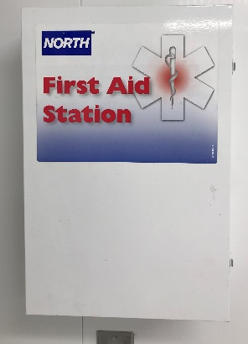
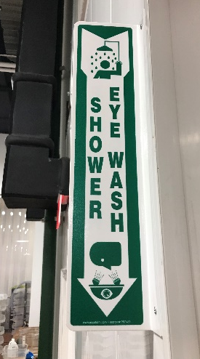
In Case of Emergency
Immediately notify a member of the Management Team of any injuries or safety concerns. In emergency, Dial 911 from cell phone or facility phones located:
  IBRL 1010 - Pilot Plant
  IBRL 2051 – Laboratory
  IBRL 1053 – Workshop
  AESB 186 – Shin Family Conference Room
First Aid Kit Locations
  IBRL 1010 – Pilot Plant Entrance
  IBRL 2051 – Laboratory West Wall
  AESB 185 – Pilot Plant Entrance
  AESB 190 - Food Analysis Laboratory
  AESB 194 – Product Development Kitchen
Defibrillator available in hallway near IBRL 1033 & in AESB near washrooms
Safety Shower & Eye Wash Locations
  IBRL 1010- East & West end of Pilot Plant
  IBRL 1072- South end of Volatile Room
  IBRL 2051- North & South end of Lab
  AESB 185 – Near Pilot Plant Entrance Hand Sink
  AESB 190 – Near Hallway Door of Food Analysis Laboratory
  Become aware of locations in your area

Slide 15
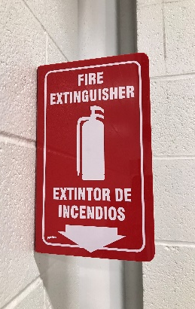
In Case of Emergency
Fire extinguishers available throughout facilities
  Become aware of locations in your work area
IBRL 2051 – Laboratory has electrical shut-off switches on both exits
(RUN) Tornado/Natural Disaster
  IBRL – Shelter in basement hallway
  AESB – Shelter in hallway next to elevator
(RUN) Fire
  IBRL – Assemble outside near IBRL dock or in AESB south hallway
  AESB – Assemble in IBRL main entrance across parking lto

Slide 16

Dress Code
Clothing
  Sleeved shirt
    NO exposed shoulders or bare stomachs
  Long Pants
    Denim or khaki material preferred
    NO sweatpants or leggings allowed
  Closed-toed shoes with ankle support
    Boots preferred; sturdy tennis shoes acceptable
    NO sandals, crocs, or lightweight shoes allowed
  No loose/long clothing, hair, or jewelry
Consult a member of the management team before brining a cell phone into the pilot plant or lab.
Locker storage (provide your own lock) and showers (bring your own toiletries/towel) available

Slide 17
Personal Protective Equipment
Safety Glasses
  Glasses and lens cleaner available
  All personal glasses must be ANSI Z87.1 certified
  “Over Glasses” Safety Glasses available
Hearing Protection
  Available for use as needed with loud equipment
Hand Protection
  Nitrile Lab Gloves
  Food Handling
  Hot-handling
  Hot and wet-handling gloves
  Work gloves
  Cryo gloves
Lab Coat
  FSHN-PPP – Required at all times in AESB 185 – Pilot Plant or AESB 194 – Product Development Kitchen (available in pilot plant entrance)
  IBRL – available in IBRL Lab Storage as needed
For special needs or other concerns, please notify the Management Team

Slide 18
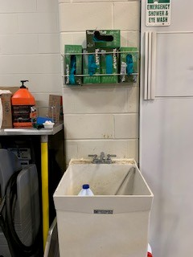
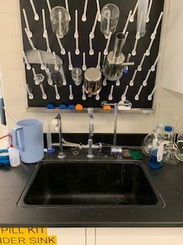
IBRL Cleaning
Your work area is expected to be kept in a clean and organized manner. Final cleaning and waste removal expectations will be discussed with the Management Team before beginning work.
Cleaning supplies are located near sink at East and West ends of Pilot Plant & middle of Laboratory
  Surplus supplies stored in IBRL 007
All solids must be swept and placed in garbage can before spraying down the floor. DO NOT wash any solids down the drain.
Be aware of electrical hazards when spraying water & cleaning equipment. Ensure all equipment is disconnected before beginning cleaning process.
Do not leave items in wash sinks
Pilot Plant
LAB

Slide 19
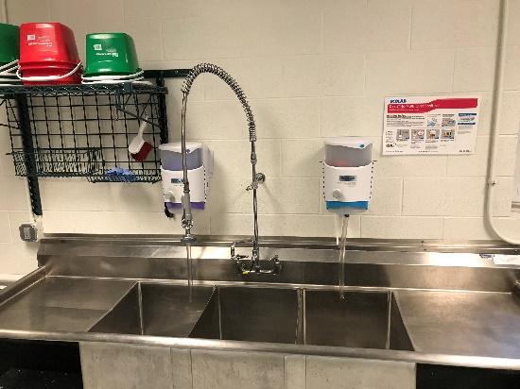
FSHN-PPP Cleaning
YOU are expected to clean after using any FSHN-PPP space or equipment
Cleaning supplies are located near sink
  Surplus supplies stored in AESB 181
All cleaning activities must properly utilize
3-basin sink, dishwasher, or mobile cleaning carts
  Wash – Remove food particles and other types of soil
  Rinse
  Sanitize – Reduce the number of microorganisms
All solids must be swept and placed in garbage can before spraying down the floor. DO NOT wash any solids down the drain.
Be aware of electrical hazards when spraying water & cleaning equipment. Ensure all equipment is disconnected before beginning cleaning process.
Do not place/leave any sharp objects in sink.

Slide 20
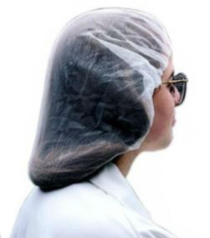
FSHN-PPP Hygiene
Hair nets required at all times
  For those with long hair, two may be necessary to fully contain hair
  Beard nets required when applicable
Hand washing
  Rinse, soap, rub vigorously for 20 seconds, rinse, dry
  Must wash
    Upon entry to the food processing facility
    After touching bare human body parts other than clean hands
    After sneezing, coughing, or touching face or mouth
    After handling soiled equipment or utensils, or switching tasks
Illnesses to exempt participation
  Sore throat with fever, vomiting, diarrhea, or jaundice in past 24 hours
  Infected cuts or burns on hands or wrists
  Diagnosis of Hepatitis A, Salmonella Typhi, toxin producing E. Coli, Norovirus, Shigella spp.

Slide 21
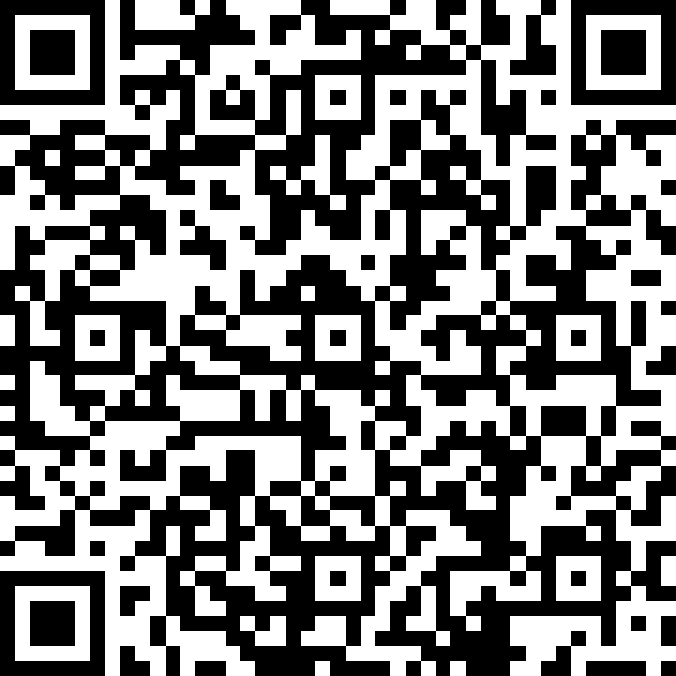
Scan the QR code to complete your Safety Orientation
This electronic forms serves as required documentation for safety compliance.
Hard copies are available upon request.

